Slide 1
Neural Network Basics
(short version)
https://github.com/timestocome/DeepLearning-Talks
( Linda MacPhee-Cobb )

Slide 2
Main types of networks
Feed forward: map dot product of inputs to outputs
Convolutional: use random noise convoluted with input to detect edges
Recurrent: stack series data shifting one step, add memory
AutoEncoder: squeeze data ( compress ) <-> decompress
Reinforcement: adjust rewards over time, keeps an array of error data instead of one error
Alpha Go: min-max tree with a feed forward network tacked on end

Slide 3
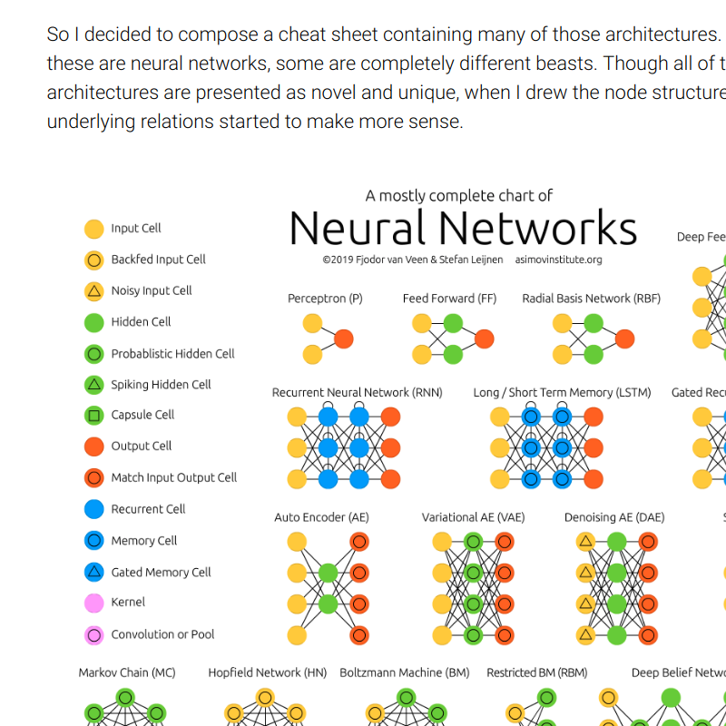
No Free Lunch Theorem
Says that if you average over all the machine learning algorithms each will have the same performance on the same data set.
The only way one strategy can outperform another is
by adjusting the network to the problem.
convolutional networks for vision
recursive networks for time series
deep vs wide layers
http://www.asimovinstitute.org/neural-network-zoo/

Slide 4
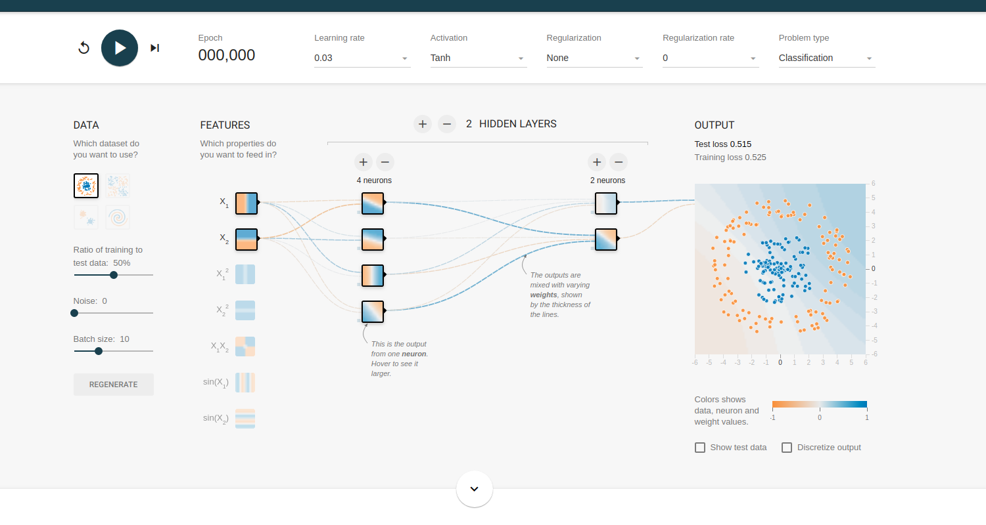
Tensorflow playground
http://playground.tensorflow.org

Slide 5
Building a Machine Learning Algorithm
Cleanup data
Multiply data by weights, iterative training for non-linear data
Minimize difference between cost function and actual data

Slide 6
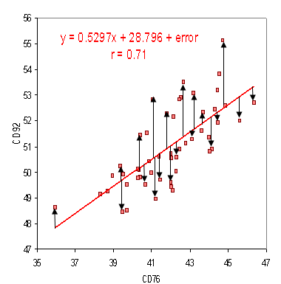
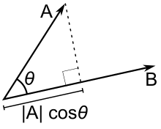
Forward Pass Feedforward Networks
prediction = dot(w.T, x)
MSE = 1/n_samples * Sum(predicted - actual)^2
Solve for unknown f(x)
J(w) = ||y - dot(w.T, x)||^2
Use derivative to find direction to change weights
dJ/dw = 2 * XTXw -2 * XTy
w = w - learning_rate * 2 * (XTXw - XTy)

Slide 7
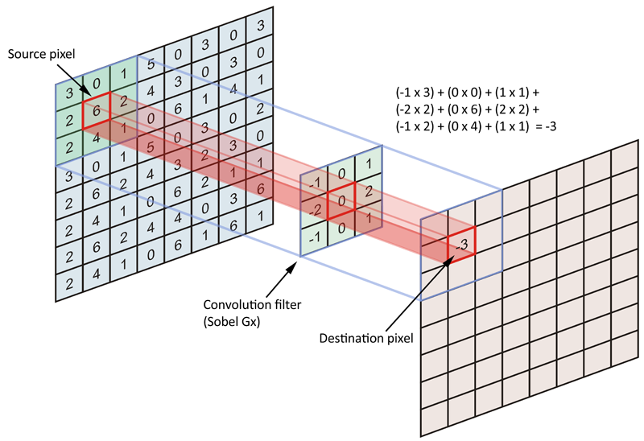
Forward Pass Convolutional Network

Slide 8
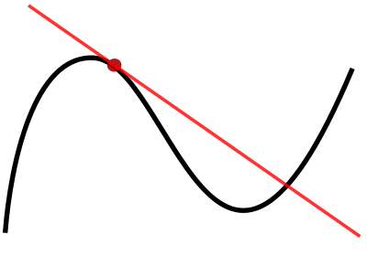
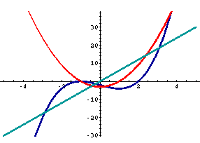
Backward Pass
Uses derivative of activation function to adjust the weights
Measures the tangent line on a slope which gives you the direction of greatest increase. In neural networks we use the negative of it to get steepest descent.
The 2nd derivative can tell you if you are at a max or min
f" < 0 max
f" == 0 no information
f" > 0 minimum

Slide 9
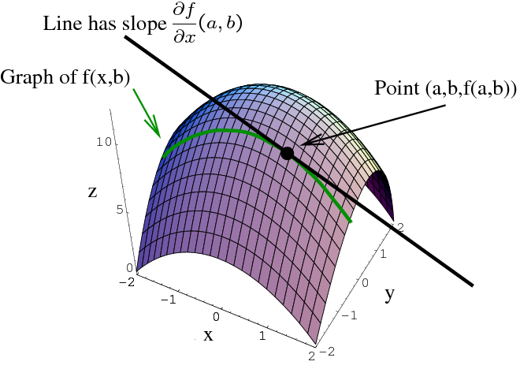
Partial Derivative
Derivatives calculated on vectors ( gradient )

Slide 10
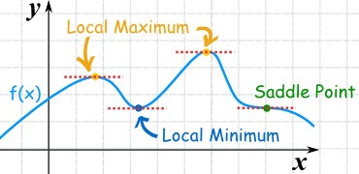
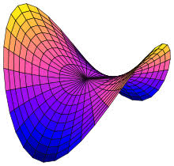
Gradient Based Optimization
Goal is to minimize or maximize a cost function ( loss function, error function)
Using a small learning rate, take a small step in the direction of steepest decrease
Gradient = 0 at minimum, max, saddle point

Slide 11
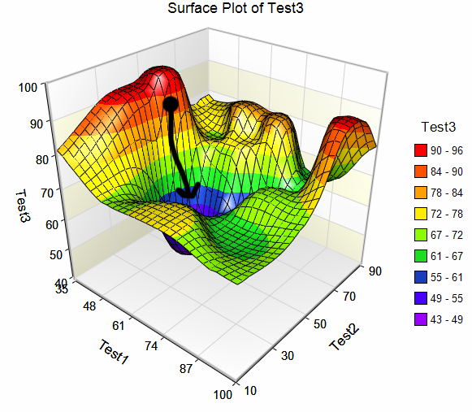
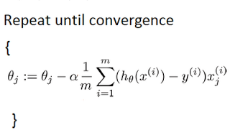
Stochastic Gradient Descent, deep nets change everything
Local mins become saddle points, then vanish completely
Possible multiple correct paths through the network

Slide 12
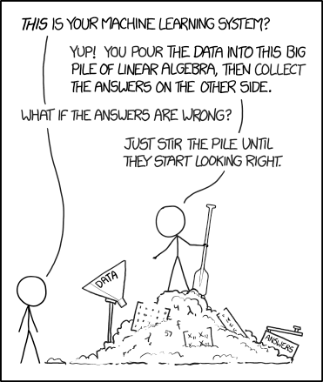
Data ...

Slide 13
Independent Identically Distributed
Garbage in, garbage out
Independent --- features cannot be correlated
one hot encoding ( M 1, F 0 should be M_F 0, 1 ) … leave one out
Identically Distributed and balanced
training, validation, test data
outputs ( if 90% of the output is true, the network will always guess true and you'll have 90% accuracy - check the confusion matrix )
https://pandas.pydata.org/pandas-docs/stable/generated/pandas.DataFrame.corr.html
http://scikit-learn.org/stable/modules/generated/sklearn.metrics.confusion_matrix.html

Slide 14
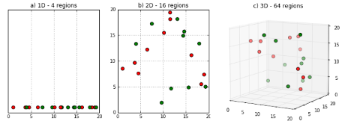
Curse of dimensionality
Linear algebra - unknowns can't outnumber features, samples
current thinking is there might be multiple correct ways through the deep networks

Slide 15
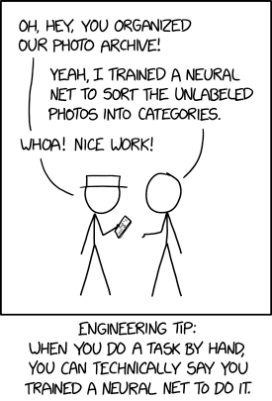
Details...

Slide 16
The Task (Goals)
This is what you want your neural network to solve, the goal
Think carefully, you can get very different answers depending on how you frame your task.
If it's not converging try a different error function
First self driving cars were trained with human drivers and learned to drive on their own.
-- Test car is successfully driven down the road, then down a hill into a lake -
- the car had learned to follow the curb, not the road
it's not always learning what you think it is learning

Slide 17
The Performance Measure ( Cost function)
~ 80% of data is used for training
~ 10% of data to validate
~ 10% of data is held out to be used as a test after training is done
While accuracy less than ( pick a number )%:
shuffle data
run training data in batches
run validation every 100th epoch or so:
Then test on hold out data after training is complete (* never let subcontractors, contest entrants see hold out data )
Training, testing, validation data must be statistically similar
Notes:
--- see if can find training to test data paper ---

Slide 18
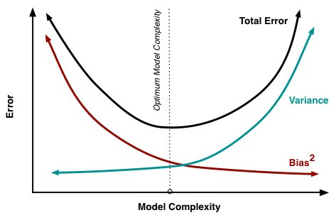
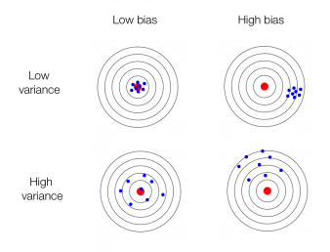
Bias vs Variance
High bias == underfitting High variance == overfitting
MSE = (target - predicted)^2 = Bias^2 + Variance + noise

Slide 19
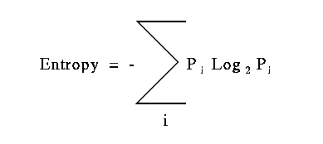
Entropy
Entropy = how many bits are needed to encode information *information theory uses Log2, not e, not 10
Coin toss: 2 possibilities (heads, tails) == 1 bit
Entropy = - Sum( (½) * log(½) + (½) * log(½) )
Entropy = - ( ½ * -1) + (½ * -1) = -(-½ - ½) = 1
Coin toss: 2 possibilities (heads ⅓, tails ⅔)
Entropy = -(⅓ * log(⅓) + ⅔ * log(⅔) ) = 0.89
A Mathematical Theory of Communication, Shannon
http://affect-reason-utility.com/1301/4/shannon1948.pdf

Slide 20
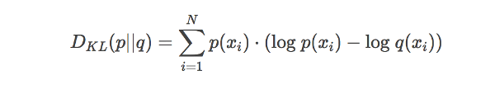
KL Divergence
Kullback-Leibler Divergence tells how much information is lost between the neural network prediction and the actual values
p is probability distribution (actual), q is approximation (predicted)
The principle of maximum likelihood says that given the training data, we should use as our model the distribution f(w) that gives the greatest possible probability to the training data
not a distance measure !
https://www.countbayesie.com/blog/2017/5/9/kullback-leibler-divergence-explained
http://cseweb.ucsd.edu/~elkan/250B/logreg.pdf

Slide 21
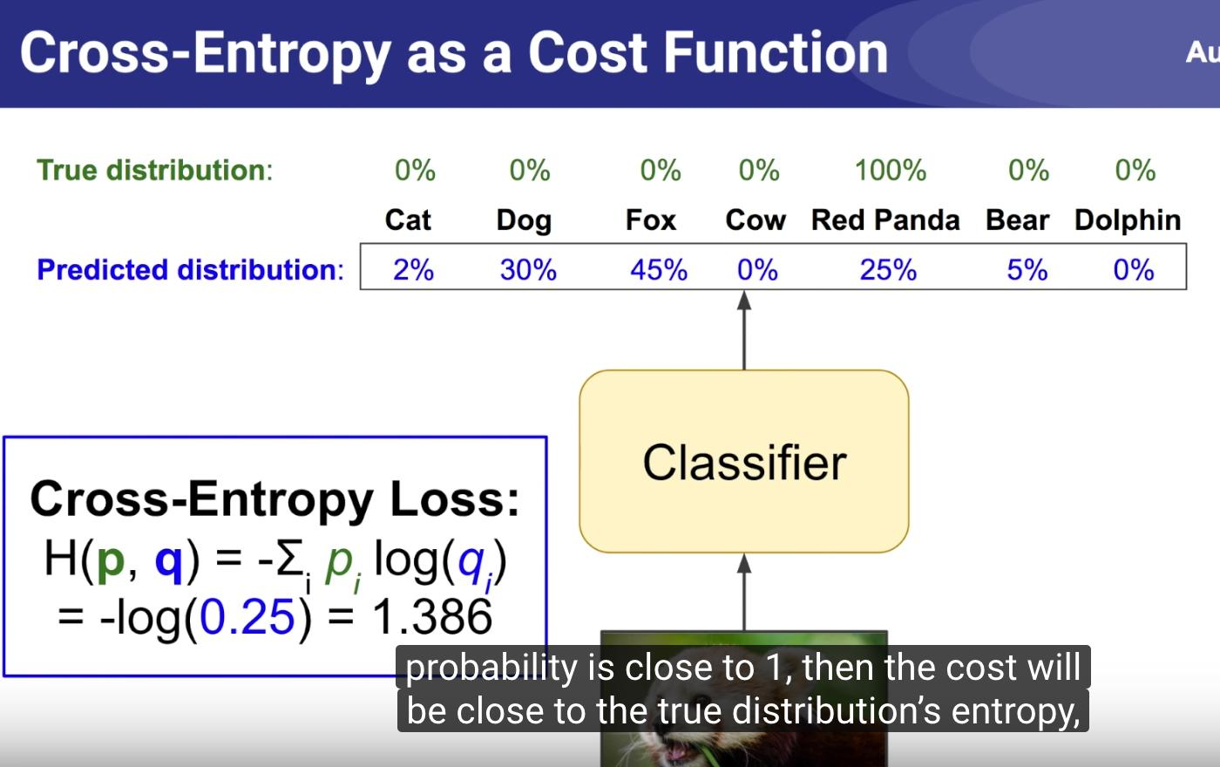
Cross entropy as cost function
Cross entropy = entropy + KL Divergence
entropy = minimum bits needed to transmit actual information
KL Divergence = difference between predicted and actual information
https://www.youtube.com/watch?v=ErfnhcEV1O8&feature=youtu.be

Slide 22
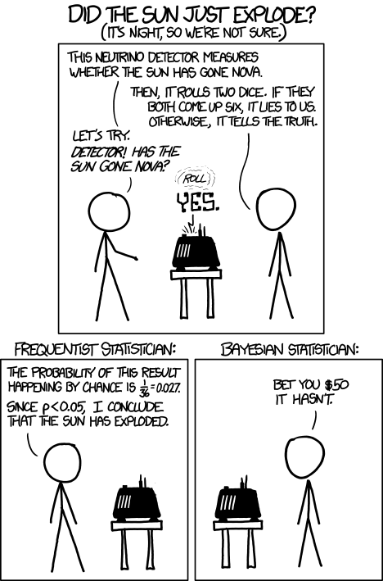
Bayes vs Frequentist
Statistical religious wars

Slide 23
Bayesian vs Frequentist
Bayesian Frequentist
Prior beliefs Repeatable random sample
Fixed parameters Fixed data
mu = mx + b y = mx + b
y = N(mu, std)
N - normal distribution
std - standard deviation
mu - mean

Slide 24
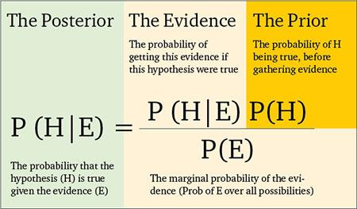
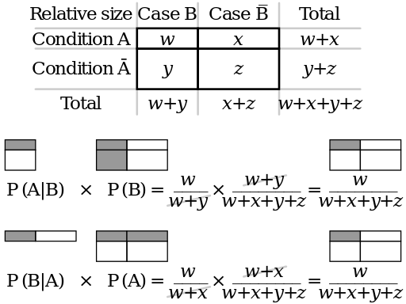
Bayesian Statistics
Intuitive understanding of Bayes
https://arbital.com/p/bayes_frequency_diagram/?l=55z&pathId=28771
http://scikit-learn.org/stable/modules/naive_bayes.html

Slide 25
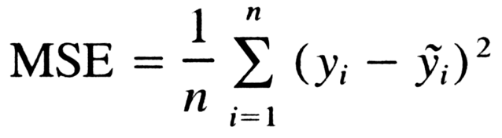
Mean Squared Error
If the data examples are i.i.d.
independent and identically distributed, then the Conditional Log Likelihood can be reduced to the Mean Squared Error

Slide 26
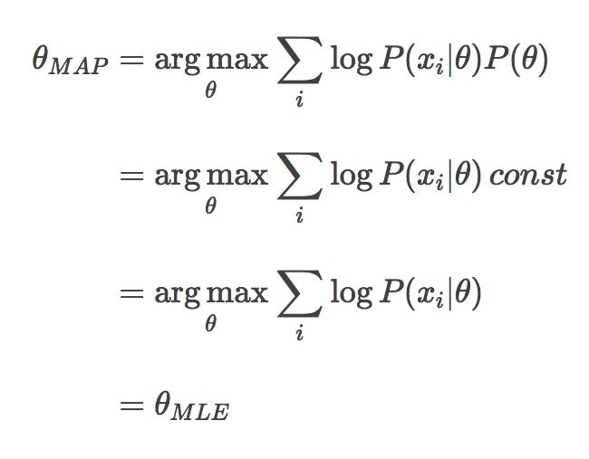
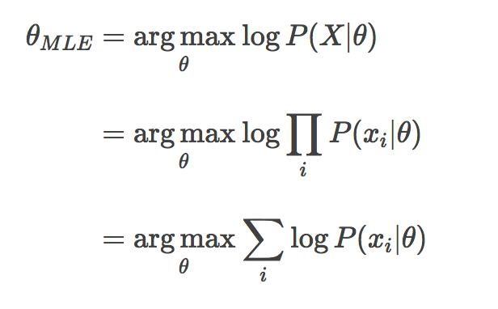
MLE (frequentist) vs MAP (bayesian)
Both compute a single value, not a distribution
MLE - fit a Gaussian to the data
MAP - uses posterior distribution
MLE is a specific case of MAP
http://papers.nips.cc/paper/3-supervised-learning-of-probability-distributions-by-neural-networks.pdf
https://wiseodd.github.io/techblog/2017/01/01/mle-vs-map/

Slide 27
Useful things

Slide 28
Cross validation
Split the dataset into 3 or more sections:
Train on one or more sections
Test on one section
Validate on one section
Shuffle data, split and repeat
Average error gives you an approximate idea of how well an algorithm will perform
Especially useful on small datasets.
http://scikit-learn.org/stable/modules/cross_validation.html

Slide 29
Hyperparameters
Variables used to control the algorithm
max, min, depth of branches on a decision tree
number of layers, size of layers in network
learning rate, complexity constant
Usually a grid search ( nested loops over several options ) is used with cross validation
http://scikit-learn.org/stable/modules/grid_search.html
A recent development is that randomly picking values for a grid search is more effective than stepping through all values.
http://www.jmlr.org/papers/volume13/bergstra12a/bergstra12a.pdf

Slide 30
Regularization
Training adjusts the weights to minimize the error, regularization forces the weights to stay small which forces the network to generalize
Used to prevent overfitting: To be useful a network must be able to generalize to new data.
L1 regularization
L2 regularization
Early stopping
Drop out
Batch normalization

Slide 31
L1 Regularization
aka Lasso
Minimize the sum of the absolute differences
Drives some weights to zero which has the effect of pruning features which acts as a feature selector. Almost never used in real problems because it is not rotationally invariant
L1 = complexity_parameter * sum(abs(W))

Slide 32
L2 Regularization
aka Ridge regression
Limits weight size without driving any to zero, minimizes variance, increases bias
Rotational invariance is the main reason it is used instead of L1
L2 = complexity_constant * sum(W)^2
L1 and L2 have the effect of choosing a different prior in Bayesian solutions
Elastic net uses both L1 and L2 https://web.stanford.edu/~hastie/Papers/B67.2%20(2005)%20301-320%20Zou%20&%20Hastie.pdf

Slide 33
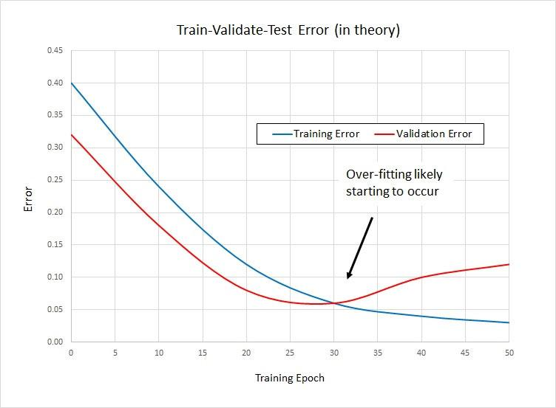
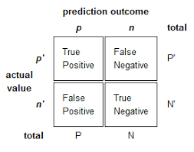
Capacity, Overfitting, Underfitting
Early stopping

Slide 34
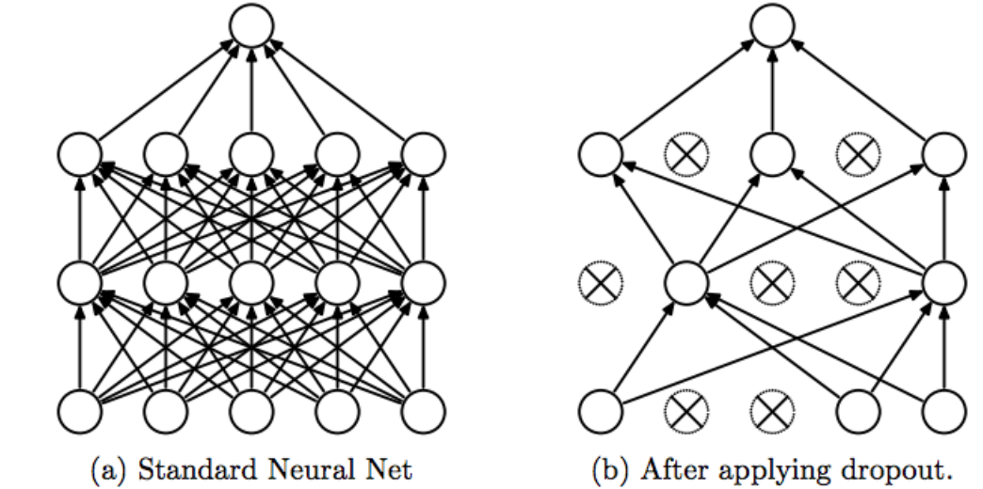
Dropout
Averages predictions over all weights
Randomly exclude a percent of hidden nodes from the neural network, change and randomly exclude a different group on next batch during training.
How to:
Create a matrix the size of the weights matrix
Randomly fill with ones and zeros
Multiply weights by the matrix
Dropout: A Simple Way to Prevent NN from Overfitting
https://www.cs.toronto.edu/~hinton/absps/JMLRdropout.pdf

Slide 35
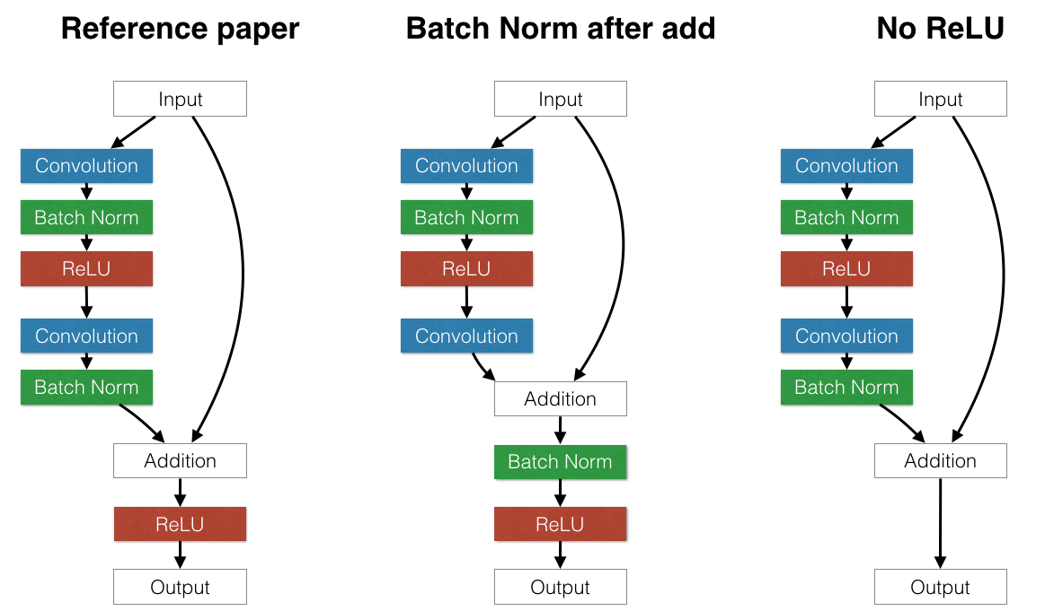
Batch Normalization
Is often used in place of DropOut, can use higher learning rates, networks train faster.
For each batch of training examples recenter the features.
In practice, the original input is fed to later layers
https://arxiv.org/pdf/1502.03167.pdf

Slide 36
Probabilistic Supervised Learning
Normal ( Gaussian Distribution )
Probability of y given x
The activation functions are used to create non-linearity
sigmoid, oldest, may cause vanishing gradients
tanh, steeper than sigmoid, still can cause vanishing gradients but usually gives better results than sigmoid
relu, not linear, combinations or Relu also nonlinear, can approximate any function, drives some weights to zero
fast to compute
leaky relu ( use when relu drives all your weights to zero )
softmax ( used in last layer to scale values so they sum up to 1, used in last layer to give probability )

Slide 37
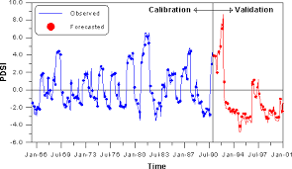
Time Series Predictions
Used to predict future values
Must be stationary (rotate down to x axis)
Generally use a log scale
Validation data must be future data
Facebook's Prophet is an open source tool for doing forecasts with large
https://facebook.github.io/prophet/

Slide 38
More information...

Slide 39
Everything old is new again
New old things being tried with better hardware, more data
Bayes algorithm, 1700s invented by a monk studying chance
NEAT, NeuroEvolution of Augmenting Topologies http://nn.cs.utexas.edu/downloads/papers/stanley.ec02.pdf
Genetic Algorithms https://www.doc.ic.ac.uk/~nd/surprise_96/journal/vol1/hmw/article1.html
Reinforcement Learning ( BFSkinner) http://www.incompleteideas.net/book/bookdraft2018jan1.pdf
AlphaGo is a modern remake of Blondie24 http://www.davidfogel.com/

Slide 40
Videos
Bay Area Deep Learning School 2016
https://www.youtube.com/watch?v=eyovmAtoUx0 and https://www.youtube.com/watch?v=9dXiAecyJrY
Deep Learning Summer School Montreal
https://www.youtube.com/playlist?list=PL5bqIc6XopCbb-FvnHmD1neVlQKwGzQyR
http://videolectures.net/deeplearning2017_montreal/
Neural Networks for Machine Learning (Hinton Lectures 78 videos)
https://www.youtube.com/playlist?list=PLoRl3Ht4JOcdU872GhiYWf6jwrk_SNhz9

Slide 41
Blogs and things
ArXiv Papers https://arxiv.org/
Uber ML Blog: https://eng.uber.com/
Deep Mind https://deepmind.com/
Netflix ML Blog: https://medium.com/@NetflixTechBlog
Aylien NLP Blog and Data: http://blog.aylien.com/research/
Open AI: https://openai.com/systems Test environments for RL learning
Kaggle: https://blog.kaggle.com/ Data, ML Blog, forums, examples, contests
Otoro: http://blog.otoro.net/ Misc cool AI

Slide 42
Tensorflow
Tensorflow https://www.tensorflow.org/
Tensorflow for poets: https://codelabs.developers.google.com/codelabs/tensorflow-for-poets/#0
https://www.youtube.com/watch?v=cSKfRcEDGUs
Github: https://github.com/tensorflow/tensorflow
TensorFlow Models https://github.com/tensorflow/models
Manning MEAP Books https://www.manning.com/meap-catalog

Slide 43
Numerical computing
Numerical Recipes in C/C++, Fortran 77/90
http://numerical.recipes/oldverswitcher.html
Introduction to Statistical Learning ( high school math )
http://www-bcf.usc.edu/~gareth/ISL/ISLR%20Seventh%20Printing.pdf
Elements of Statistical Learning ( college level math )
https://web.stanford.edu/~hastie/Papers/ESLII.pdf
The Nature of Statistical Learning Theory ( graduate level math )
https://www.springer.com/us/book/9780387987804

Slide 44
Deep Learning
Neural Networks and Deep Learning http://neuralnetworksanddeeplearning.com/
Must Know Tricks in Deep Neural Networks http://lamda.nju.edu.cn/weixs/project/CNNTricks/CNNTricks.html
Neural Network Zoo http://www.asimovinstitute.org/neural-network-zoo/
Neural Network Playground http://playground.tensorflow.org
WildML http://www.wildml.com/

